Slide 1
Task 1
Laravel
Fullname: Lê Thanh Sơn

Slide 2
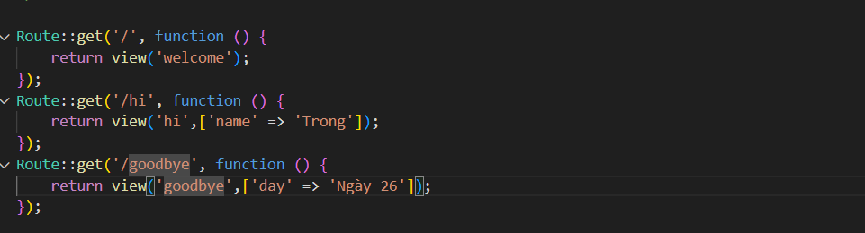
EXE 1
Screenshot of root file web.php, replace the image below

Slide 3
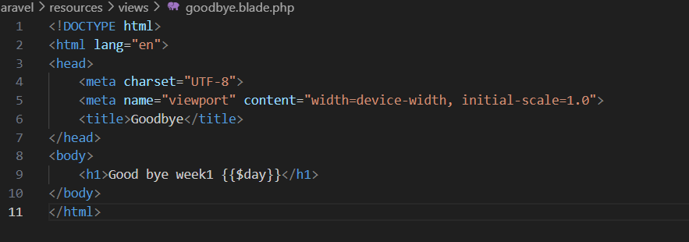
EXE 1
Screenshot of the view blade file, replace the image below

Slide 4
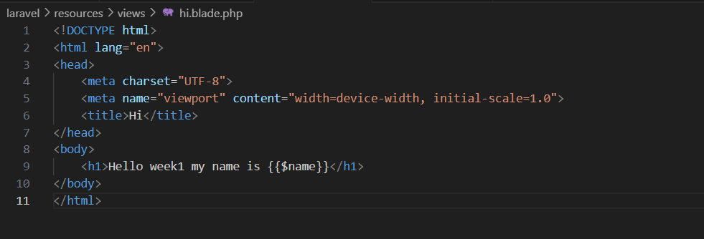
EXE 1

Slide 5
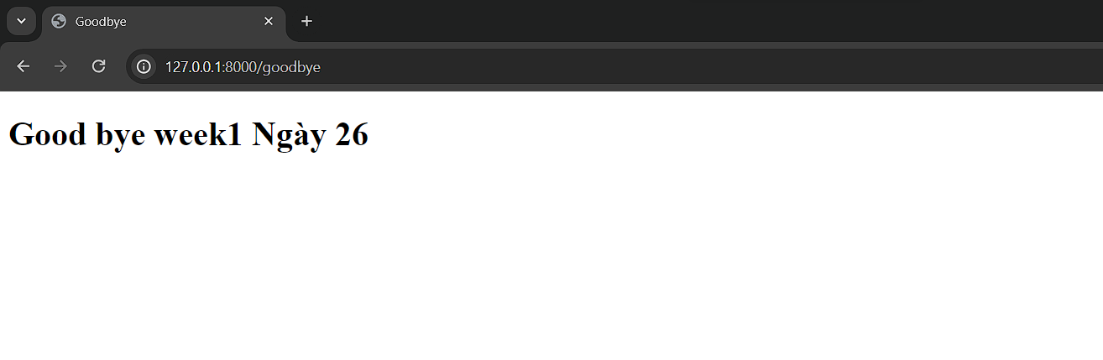
EXE 1
Screenshot of the result, replace the image below

Slide 6
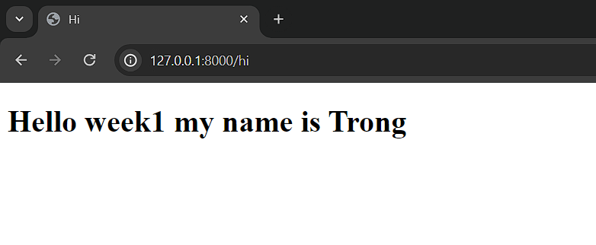
EXE 1

